Slide 1
IENG 461 – System Safety I
Lecture 4 – System Life Cycle

Slide 2
System Life Cycle
Overview of tonight’s topics
  Prevention through Design (PtD)
  Hierarchy of controls
  PtD examples

Slide 3
System Life Cycle
ANSI/ASSE Z590.3-2011 “Prevention through Design - Guidelines for Addressing Occupational Hazards and Risks in Design and Redesign Processes” (64 page document)
Motivation for standard:
  Significant reductions will be achieved in injuries, illnesses and damage to property and the environment, and their attendant costs.
  Productivity will be improved.
  Operating costs will be reduced.
  Expensive retrofitting to correct design shortcomings will be avoided.

Slide 4
System Life Cycle
Z590.3 scope: “This standard provides guidance for a life-cycle assessment and design model that balances environmental and occupational safety and health goals over the life span of a facility, process, or product.”
People, property, environment

Slide 5
System Life Cycle
Z590.3 committee membership:
  Black & Decker
  GE Healthcare
  NIOSH
  Kuwait Oil Comp.
  Owens Corning
  Walt Disney World

Slide 6
System Life Cycle
Z590.3 specific goals:
Hazards are anticipated, identified, and evaluated for avoidance, elimination, or substitution.
Risks deriving from identified hazards are assessed and prioritized in accordance with accepted hazard analysis and risk assessment techniques.
Risks are reduced to an acceptable level through the application of the hierarchy of controls…

Slide 7
System Life Cycle
The knowledge, skills, experience, insight, and creativity of employees close to the hazards and risks are utilized in the risk assessment process.
Design and/or redesign process effectiveness is monitored through feedback between employees and management to provide for continuous improvement.
Appropriate recordkeeping systems are developed and used to document design reviews and to track feedback and safety and health reports over the life cycle.

Slide 8
System Life Cycle
When do we apply PtD?
New facilities, equipment, technologies, materials, and processes are being planned, designed, acquired, or installed.
Alterations are made in existing facilities, equipment, technologies, materials, and processes.
Incident investigations are made and corrective actions are taken.
Demolition, decommissioning or reusing/rebuilding operations are undertaken.

Slide 9
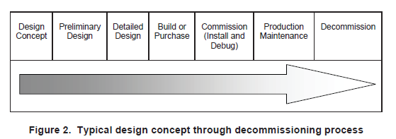
System Life Cycle

Slide 10
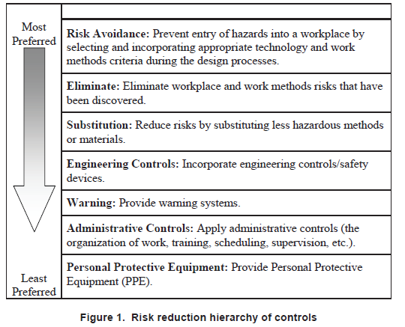

Slide 11
Less prone to defeat.
Rely least on human behavior.

Slide 12
System Life Cycle
Risk avoidance: very effective at procurement/purchasing stage
Elimination: lumberjack vs. feller buncher (see next slide)

Slide 13
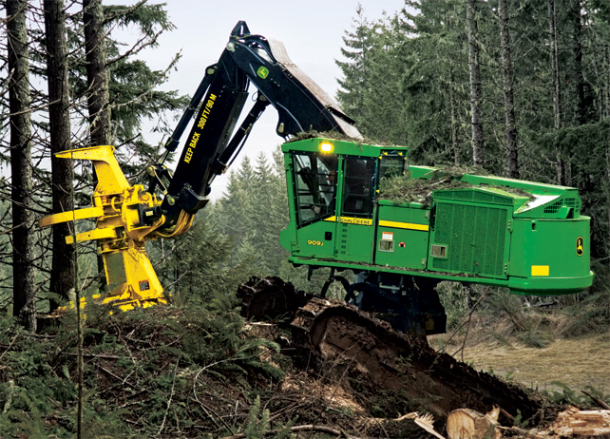

Slide 14
System Life Cycle
Substitution: reducing toxicity of chemicals in process
Engineering Controls: presence sensing – SawStop

Slide 15
System Life Cycle
Group exercise

Slide 16
System Life Cycle
Based on PtD, selected design should:
Achieve an acceptable risk level.
Minimize the probability of personnel making human errors because of design inadequacies.
Minimize the ability of personnel to defeat the work system and the work methods prescribed.
Consider human factors – the capabilities and limitations of the work population…

Slide 17
System Life Cycle
Minimize hazards and risks with respect to access and the means for maintenance.
Minimize the need for personal protective equipment, and provide aid for its use where it is necessary (e.g., anchor points for fall protection).
Meet applicable laws, codes, regulations, and standards.
Consider any recognized code of practice (internal or external).

Slide 18
System Life Cycle
PtD examples
  NIOSH FACE 2007-03 (link)
  NIOSH FACE 2003-13 (link)
  NIOSH FACE 2006-02 (link)

Slide 19
System Life Cycle
Summary
  Prevention through Design concept – design safety in (save $$)
  Consider full life cycle of product – especially maintenance procedures
  Utilize the Hazard Control Hierarchy

Slide 20
System Life Cycle
Preview of next week
  Risk assessment techniques
    Language of risk
    Risk matrix concepts
    Review/discussion for Exam 1
Homework #2: Pick 3 FACE cases involving PtD (link) [not the 3 we discussed]. For each case, identify the hazard and give specific examples of how to use the Hazard Control Hierarchy to reduce risk. Use 3 different levels of the hierarchy for each hazard (e.g. eliminate, substitute, etc.). Submit electronically before 5:30 on 9/19. Please name lastname_HW2 (e.g. Harris_HW2).
Exam 1 – 9/19 (discussion during 9/12 lecture)

Slide 21
System Life Cycle
More detail on HW 2
FACE Case #1 (state what FACE case #)
  Hazard
    Risk reduction technique 1
    Risk reduction technique 2
    Risk reduction technique 3
(Repeat for a total of 3 cases)
Each technique from a different part of Hazard Control Hierarchy

